Slide 2
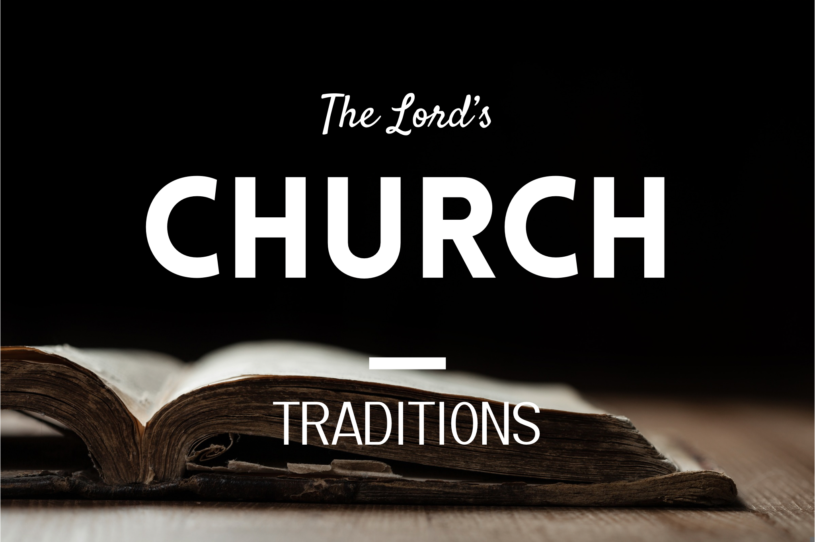

Slide 3


What does the Bible say?
Traditions: handed down/given over
Traditions from God (2 Thess 2.14-15, 3.6)
Traditions from men (Col. 2.6-8, 1Pet.1.18, Mk 7.1-5)
Notes:
Being in Christ does not require being a member at a local church or part of a local fellowship. They were baptized into Christ.
Then they went on their way and they had to maintain that fellowship with Him.
We learned how you do that from 1 John 1:1-2:1 last week. CLICK

Slide 4
Processing Traditions
Is it from men or God?
It is impossible to be non-traditional
Change for change sake isn’t helpful
Teaching as doctrines the commandments of men (Mk. 7:6-9)
Notes:
Being in Christ does not require being a member at a local church or part of a local fellowship. They were baptized into Christ.
Then they went on their way and they had to maintain that fellowship with Him.
We learned how you do that from 1 John 1:1-2:1 last week. CLICK

Slide 5
Questions to ask:
Is it from God or from men?
If from men:
Is it added or within the “how”?
Is it helpful/edifying? 1 Cor. 10:23
Do the elders have authority?
Notes:
Being in Christ does not require being a member at a local church or part of a local fellowship. They were baptized into Christ.
Then they went on their way and they had to maintain that fellowship with Him.
We learned how you do that from 1 John 1:1-2:1 last week. CLICK

